Slide 1
Word Processing Part 2

Slide 2
Objectives
The objectives of these topics are to provide information about:
How to adjust basic settings of MS word
Inserting different types of data in MS word
Inserting characters, Word sentence and Text
Undo Command
New Paragraph Insertion
Special Character and symbols
How to insert and delete columns and rows from table?
How to format borders and change colors?
How to use images in documents?

Slide 3
Change Page Display Mode
We can change Display mode of MS word with the purpose of how page will be displayed to us.
Display mode can be changed to following option:
Print Layout
Full Screen Reading
Web Layout
Outline
Draft
To change the display mode, we need to click on View Ribbon Tab after clicking on View Tab on the very left we can find Document Views segment with different options of how the document will be displayed we can click on the required layout to set it for the current document.

Slide 4
Change Zoom level
We sometimes need make document bigger or smaller with the intention of viewing a document more clearly or view more than one pages at the same time.
To change zoom settings from view Ribbon Tab, click on Zoom, a new window will be opened with different zoom levels select the required zoom level and press OK.
Zoom level can be changed with some other methods as well from the bottom right of the document we can see + and – Signs with a bar we can adjust zoom level from there.

Slide 5
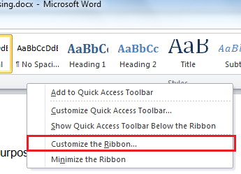
Edit Ribbon Tabs
To edit ribbon tabs first right click on ribbon tabs and select customize The Ribbon Option From there.

Slide 6

Edit Ribbon Tabs
A new window will be opened with many options in it. Below are some features we can use to edit our ribbon bar:
In the right-side menu, we can check and uncheck a tab to show or hide it from ribbon tab.
We can move a ribbon tab up or down with buttons to change its position in ribbon tabs.

Slide 7
Changing file Format
Sometimes we need to save a file in specific format so that it can be opened in other software as well.
To change file format from File Menu we click on Save As option a new window is opened, from this newly opened window we will click on save as option to change the file format and click save to save file.

Slide 8
Inserting Text
To insert text into already written document or text we simply right click on the required position and simply insert the text we want to insert.

Slide 9
Undo Command
To undo the last action in MS Word we click on undo button from quick access menu bar. We can do this with keyboard short cut key CRTL+Z.

Slide 10
Insert Special Character and Symbols
Sometimes we need to insert mathematical symbols and characters which are not available on keyboard.
To this from insert tab we click on symbol on the right side.
A small drop down will be opened with some symbols in it we can select the symbol if we want or click on more symbols to select from more symbols and Special characters.

Slide 11

Selecting, Cutting, Copy and Paste Operations Selecting Text
Text can be selected using mouse left button or Using key from Keyboard. To select text, we press and hold the mouse left button and move the mouse over the text to select selected text will highlighted, same with using shift key we press and hold shift key and press left or right arrow button or move mouse over the text to select.

Slide 12
Copy, Cut and Paste Text
We can copy or cut a text and later paste it in same document or another document.
To copy selected text, we use copy button from clipboard which is present at upper left corner of the application. Shortcut key from keyboard CRTL+C.
To cut the text we use cut button from clip board or use shortcut key from keyboard CRTL+X.
To Paste the text, we can use paste button from clipboard or use Shortcut key from keyboard CRTL+V.

Slide 13
Searching and Replacing Finding Text in Document
To find a certain word or in a document we can use find feature of the MS Word, find button is on the upper right corner of the MS Word. Shortcut key from keyboard CRTL+F.
Feature can be used to find a phrase in the document.

Slide 14
Finding and Replacing Text in Document
We can also replace a word in the document in MS Word; sometimes we need to replace a specific word in the document which has already been written for example we have a document in which President of Pakistan’s Name is Musharaf and we need to change it Mamnoon Hussain so it is better to use find and Replace feature of MS Word.
To use Find and Replace we will click on from upper right corner just below the find.

Slide 15
Finding and Replacing Text in Document
A new window will be opened with two text boxes, in the Find What field we will write the text we want to find and in the Replace field we will write the text we want to replace with the entered text and click Replace All Button to replace all or Simple Replace to Replace one by one.

Slide 16

Changing Font Properties
Font is the style how the text will be displayed
in the document. To change font from Home Ribbon bar
we will use font segment.
This toolbar has many options in it below are some things we can do with it:
We can change the font Style to another one for example Times New Roman or Broadway.
Font Size can be increased to make text bigger or smaller.
We can make text highlighted or change text color.

Slide 17
Bold, Italic and Underlined
We can make Text bold by clicking on B or make it Italicize by clicking on I or Make it Underlined.
Shortcut Keys for making text bold, italic or Underlined are as follows.
Bold CRTL+B
Italic CRTL+I
Underlined CRTL+U

Slide 18

Indentation
We can add spacing before new lines and in between lines in MS Word.
To add new line space, we press button from keyboard.
To change line spacing we press button from Paragraph Tab of Home Ribbon Bar.

Slide 19
Changing Text Colors
To change Text colors in MS Word we use Font Tab from Home Ribbon bar. To change text color, click on the.
A dropdown will be opened with many colors in it we first select the text and then chose the color we want for the selected text.

Slide 20
Alignment and Justification
Sometimes we have a special need to align text right or in the center MS word makes it easy in the ParagraphTab . These are the alignment buttons we use to left, center and right align respectively.
Shortcut keys for Alignments of text are:
Left Align CRTL+L
Center Align CRTL+E
Right Align CRTL+R
We can also justify text in MS Word by click on justify Button or use shortcut key CTRL + J.

Slide 21

Borders
MS Word Provides the Facility to insert borders to a paragraph or to full page.
To insert borders, we use Page Layout from Ribbon bar and select a new window will be opened with many options in it we can select the border width, color and style and then click OK to insert the border.

Slide 22
Bullets
To make points in the document we use bullets in MS Word.
To insert Bullets in Home Tab from Paragraph sub Tab we can click on to insert bullets. MS Word have different type of bullets which include numeric, alphabetic and styled bullets we can chose any of these as per requirement.

Slide 23

Changing Page Size/Setup
Sometimes we need to change page size or style on which we are typing as per our printing or other requirements.
To change page setup, we first click on Page Layout Ribbon Bar then in the Page Setup
We can change Margins, Orientation and Size of the Page.

Slide 24
Spelling and Grammar
MS Word have built in Grammar we can use to correct spelling and other grammatical errors, whenever we write wrong spelling MS word automatically recognize it and underline it red to let us know that it wrong. We can right click on the underlined word and chose the correct spellings.

Slide 25
Tables – Introduction
We usually use text in our documents. We can also use charts, graphs and pictures in our document file. Tabular data makes it easier for the reader to understand the information provided.
Example of tabular data can be
School Timetable
Employee contact list
Product sales report
Drawing, charts and pictures can make a document look better and easy to understand.

Slide 26
Tables
Rows and columns can be inserted into already built table, to insert a row or column select the place where you want to insert row or column then right click on it and from options menu select insert then select insert row or column to the left, right below or above the current row or column.
Rows and columns can also be deleted from an existing table, to delete a row or column select the row or column and right click on it then select Delete cells option to delete the rows or column and data with it as well.

Slide 27
Changing Table Borders
Borders of a Table can be styled according to requirements and needs.
To change border of a Table first select the Table then select Design Tab from table Tools..
After clicking on design Tab click on Borders. A drop-down menu will be opened with many features in it for different type of borders. We can select the border which we want to show/ hide. The last option in this drop down is Border and Shading. Upon clicking on Border and Shading a new window will be opened in this window we can select the border type, and color as per our requirements.

Slide 28
Inserting Pictures
A picture is worth thousand words.
MS Word allows us to use pictures in the document to make it more self-explaining. For example, we are writing an article about embedded computers so, if we can show a picture of embedded computer in the article the reader will know without even reading the document that this article is about computers or more precisely embedded computers.
To insert a picture into we have many ways some are discussed below:

Slide 29


Inserting Pictures
First Method is to use Insert Tab from Ribbon bar. Click on Insert Tab click on a new window will be opened to select picture from computer disk.
Second method is to drag and drop a picture straight from folder to MS Word.
Pictures can resized and rotated as well, to do this we click on the inserted picture and then use the mouse to resize and rotate as per requirement.
MS Word also provides the functionality of using already created graphics known as clip arts to insert the clip art same method is used as picture we click on from insert tab a side bar will be opened from this bar we can search a clipart online.

Slide 30
Printing a document
We can take prints of a document prepared in word processor. The files created using software and saved in computer called “soft copy”.
To take the print you can do any of the following.
Go to File < Print or
Press Ctrl + P

Slide 31
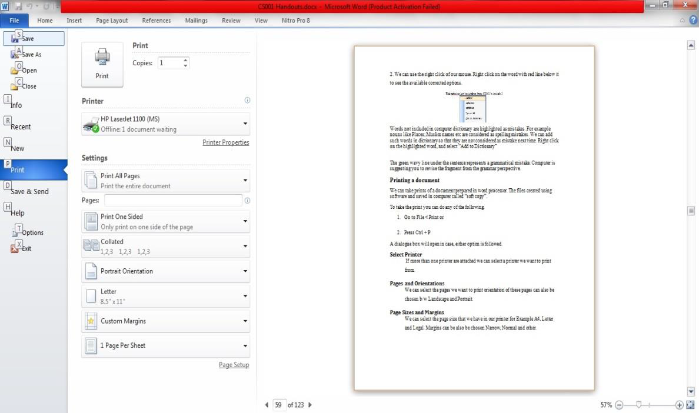
Printing a document
A dialogue box will open in case, either option Is followed.

Slide 32
Thanks

